Slide 1
OO Design & Patterns
BACS2023
Object-Oriented Programming Techniques
Chapter 8

Slide 2
Introduction
This chapter focuses on the analysis and design of software systems using the object-oriented approach.
You will learn class-design guidelines, and the techniques and patterns for designing reusable classes.

Slide 3
Learning Outcomes
At the end of this chapter, you should be able to
Explain the various relationship types: association, aggregation, composition, dependency, strong inheritance, and weak inheritance.
Discover classes and determine responsibilities of each class.
Declare classes to represent the relationships among them.
Design classes that follow the class-design guidelines.
Describe the use of design patterns for developing sound software systems.
Notes:
3

Slide 4
1. Introduction
Steps involved in Class Design
1. Identify classes for the system.
2. Describe attributes and methods in each class.
3. Establish relationships among classes.
4. Create classes.

Slide 5
2. Discovering Classes
The key to OO programming is to model the application in terms of cooperative objects.
Careful design of classes is critical when a project is being developed.
In the development of an OO program
Class abstraction is applied to decompose the problem into a set of related classes, and
Method abstraction is applied to design individual classes.
🡺To identify and determine the responsibilities of each class.

Slide 6
Strategies for Discovering Classes (1)
Step 1
Look for nouns in the problem description.
E.g., to design an IS for a university, you would identify Student, Lecturer and Course as classes.
Step 2
Determine the responsibilities of each class, i.e. the methods carried out by the objects of the class.
Look for verbs in the problem description and match the verbs to appropriate objects.
E.g., “a student registers for a course.”
Registering for courses is the responsibility of the Student class.
The Course class is involved in this operation as a collaborator for the operation.

Slide 7
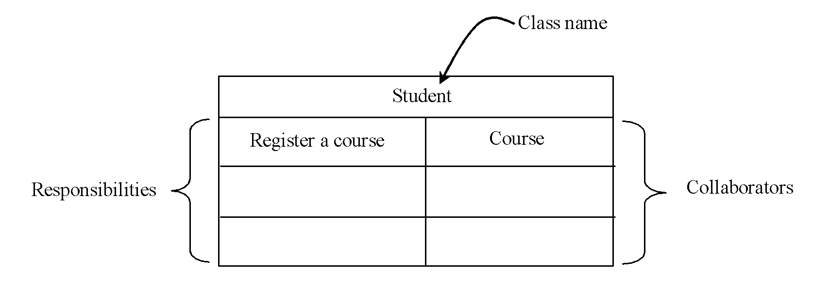
Strategies for Discovering Classes (2)
One popular way for facilitating the discovery process is by creating CRC cards (Classes, Responsibilities, and Collaborators)
Use an index card for each class, as shown in the figure below.

Slide 8
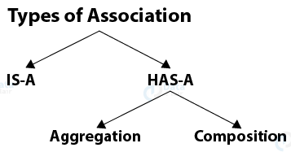
3. Discovering Class Relationships
Common relationships among classes:
Association
Aggregation and Composition
Dependency
Inheritance

Slide 9
Association (1)
Association represents a general binary relationship that describes an activity between two classes.
E.g.
A student taking a course is an association between the Student class and the Course class.
A faculty member teaching a course is an association between the Faculty class and the Course class.
take
teach
5..60
*
0..3
1
Student
Course
Faculty
Teacher

Slide 10
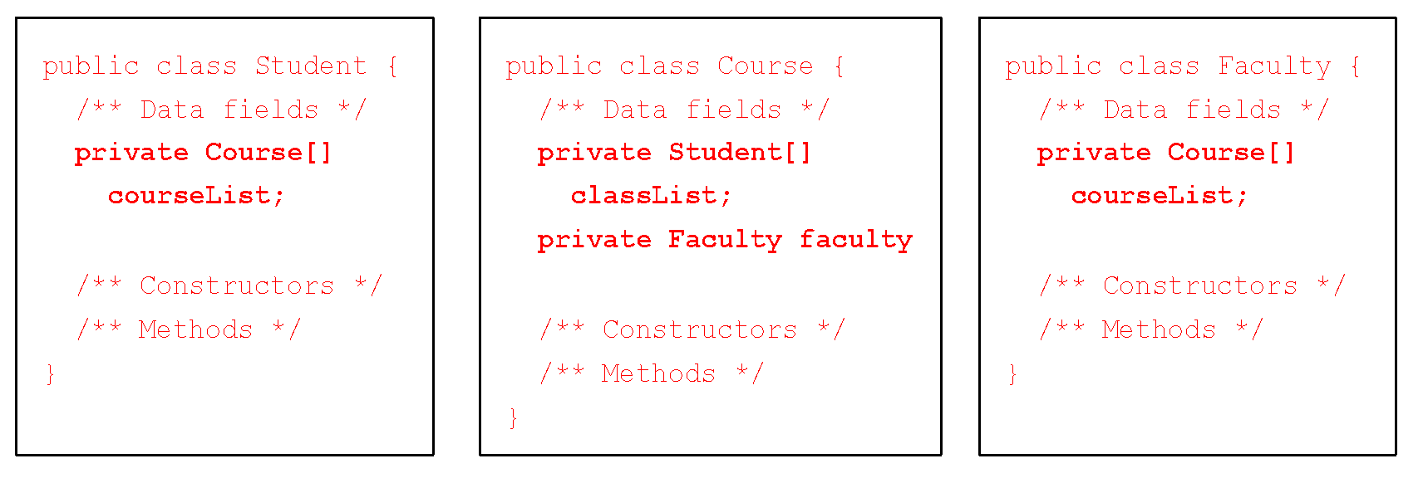

Association (2)
Labels
Role Name
Multiplicity
An association is usually represented as a data field in the class.

Slide 11

Note
There are many possible ways to implement relationships, e.g.:
The student and faculty information in the Course class can be omitted, since they are already in the Student and Faculty class.
If you do not need to know the courses a student takes or a faculty teaches, the data field courseList in Student or Faculty can be omitted.

Slide 12
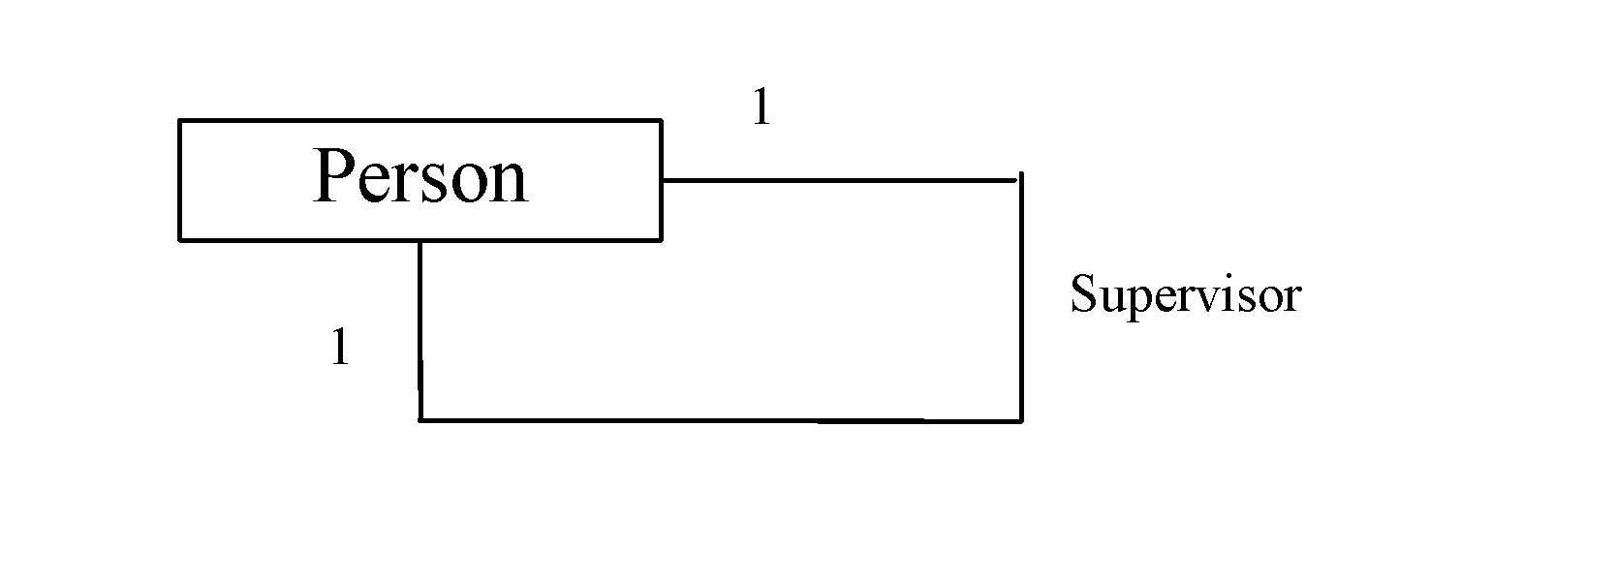
Association Between Same Class
Association may exist between objects of the same class. For example, a person may have a supervisor.

Slide 13
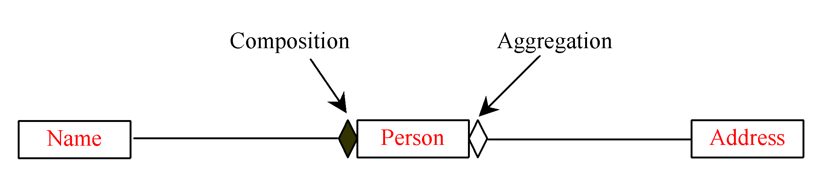
Aggregation and Composition (1)
Aggregation is a special form of association, which represents an ownership relationship between two classes.
If an object is exclusively owned by an aggregated object, the relationship between the object and its aggregated object is referred to as composition
“a student has a name” is a composition relationship between the Student class
and the Name class.
“a student has an address” is an aggregation relationship between the Student
class and the Address class, since an address may be shared by several students.

Slide 14
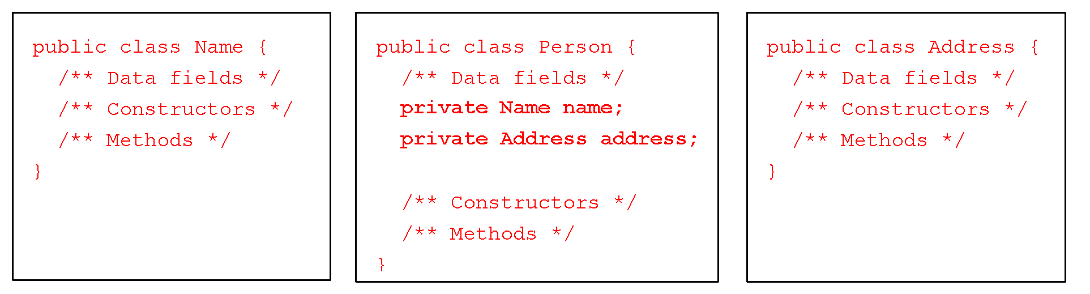
Representing Aggregation in Classes (1)
An aggregation relationship is usually represented as a data field in the aggregated class.
Aggregated class
Aggregating class
Aggregated class

Slide 15
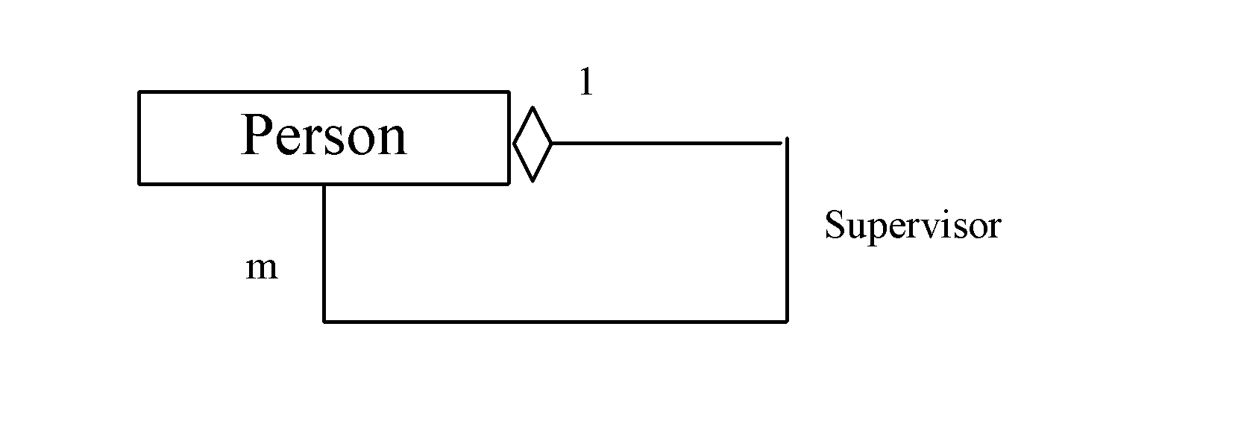
Representing Aggregation in Classes (2)
If a person has several supervisors, you may use an array to store the supervisors.
public class Person {
private Person[] supervisors;
}

Slide 16
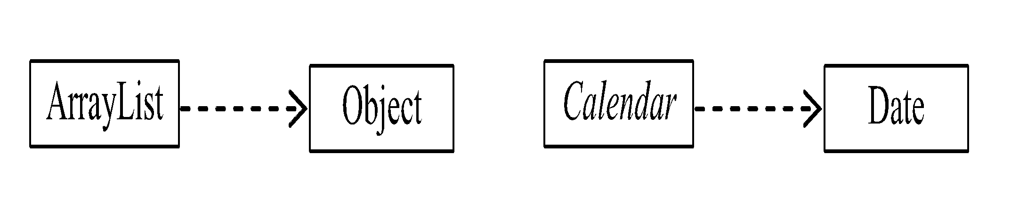
Dependency (1)
A dependency describes a relationship between two classes where one (called client) uses the other (called supplier).
In UML, draw a dashed line with an arrow from the client class to the supplier class.
The Calendar class uses Date by setting calendar with a specified Date object. The relationship between Calender and Date can be described using dependency.
Client
Supplier

Slide 17
Dependency (2)
A dependency can be implemented using a method in the client class.
The method contains a parameter of the supplier class type, e.g.:
The Calendar class has the setTime(Date) method that sets a new time in the calendar.
public abstract class Calendar {
public void setTime(Date d)
. . .
}

Slide 18
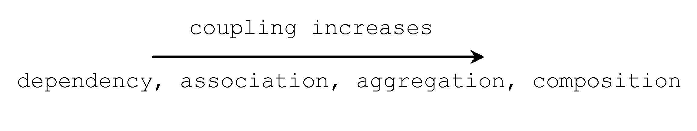
Coupling
Dependency, association, aggregation, and composition all describe coupling relationships between two classes.
The difference is the degree of coupling with composition being the strongest, followed by aggregation, association, and dependency in this order.

Slide 19
Dependency vs. Association (1)
SIMILARITY:
Both describe one class as depending on another.
DIFFERENCES:
 | Association | Dependency
Relationship | Stronger | Weaker
Description | The state of object changes when its associated object changed | The client object and the supplier object are loosely coupled
Java Implementation | Date Fields Methods | Methods ONLY
take
5..60
*
Calendar
Date
Student
Course

Slide 20
Dependency vs. Association (2)
If class A contains a method with a parameter whose type is a class B, A is said to be dependent on B.
If class A contains a data field whose type is class B, the relationship between the classes is association.
public class A {
public void aMethod(B b)
. . .
}
public class A {
private B b;
. . .
}

Slide 21
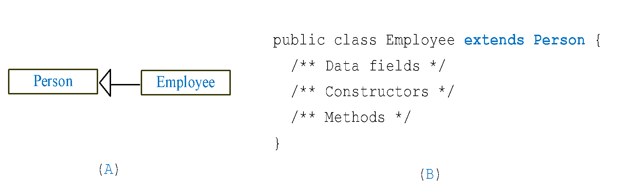
Inheritance
Inheritance models a strong is-a relationship between two classes.

Slide 22
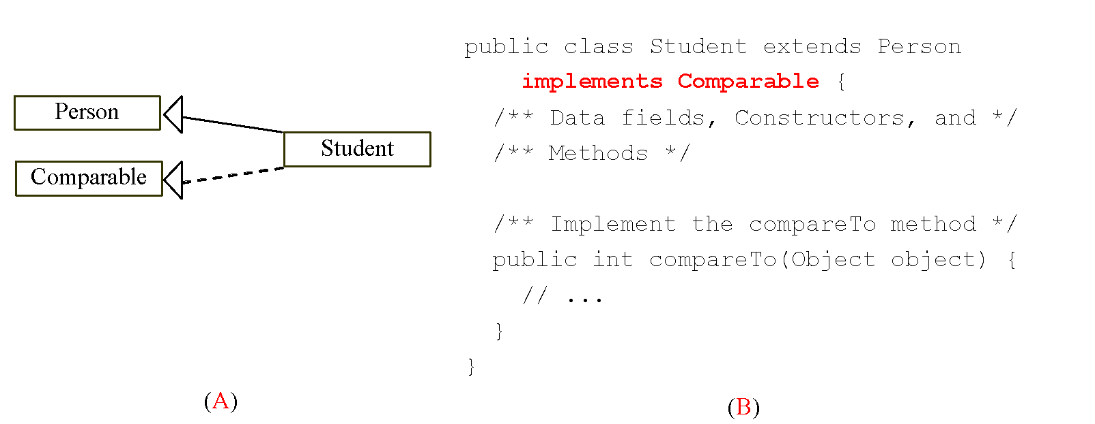
Weak Inheritance Relationship
A weak is-a relationship can be represented using interfaces.
E.g., the weak is-a relationship “students are comparable based on their grades” can be represented by implementing the Comparable interface, as follows:

Slide 23
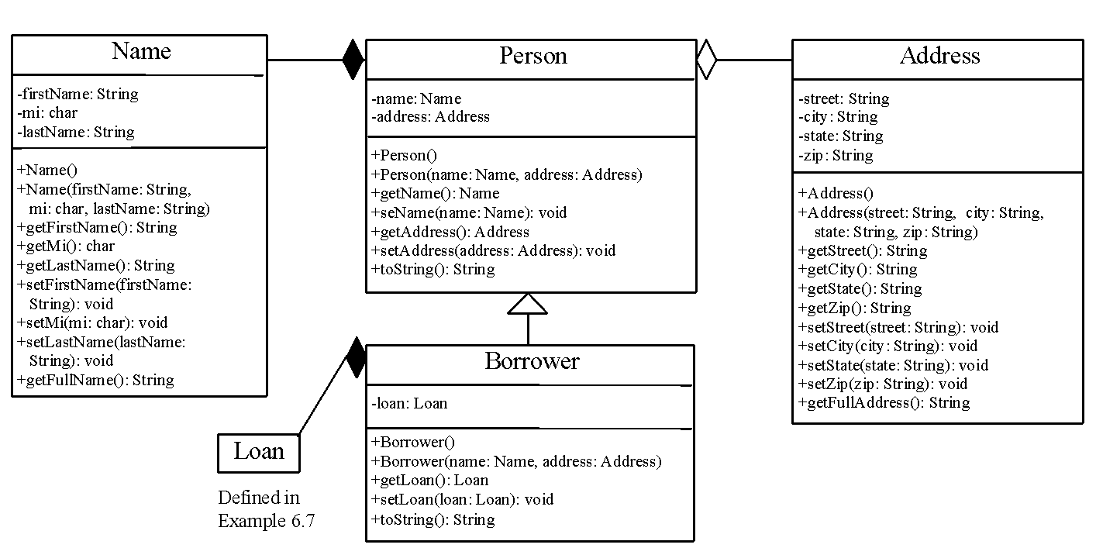
Example : Borrowing Loans

Slide 24
3. Class Design Guidelines
Cohesion
Consistency
Encapsulation (https://www.scientecheasy.com/2020/07/encapsulation-in-java.html/) – A good source to read for further understanding
Clarity
Completeness
Instance vs. Static
Inheritance vs. Aggregation
Interfaces vs. Abstract Classes

Slide 25
A. Cohesion
A class should describe a single entity.
All the class operations should logically fit together to support a coherent purpose.
E.g., you should not combine students and staff in the same class.
A single entity with too many responsibilities can be broken into several classes to separate responsibilities.
Example:
String – deals with immutable strings.
StringBuilder – create mutable strings.
StringBuffer – similar to StringBuilder, except synchronized methods for updating strings.

Slide 26
B. Consistency
Follow standard Java programming style and naming conventions.
Choose informative names for classes, data fields, and methods.
Always place the data declaration before the constructor, and place constructors before methods.
Always provide a constructor and initialize variables to avoid programming errors.
Provide a public no-arg constructor and override the equals method and the toString method defined in the Object class whenever possible.

Slide 27
C. Encapsulation (1)
A class should use the private modifier to hide its data from direct access by clients.
You can use get methods and set methods to provide users with access to the private data, but only to private data you want the user to see or to modify.
A class should also hide methods not intended for client use.

Slide 28
C. Encapsulation (2)
Each class can present two contracts – one for the users (clients) of the class and one for the extenders of the class.
Make the fields private and accessor methods public if they are intended for the users of the class.
Make the fields or method protected if they are intended for extenders of the class.

Slide 29
D. Clarity
Implement cohesion, consistency and encapsulation to help achieve clarity.
In addition, a class should have a clear contract that is easy to explain and easy to understand.
Classes are designed for reuse.
Users can incorporate classes in many different combinations, orders, and environments.
Therefore, you should design a class that imposes no restrictions on what or when the user can do with it, design the properties to ensure that the user can set properties in any order, with any combination of values, and design methods to function independently of their order of occurrence.
You should not declare a data field that can be derived from other data fields.
Eg: public class Person{
private java.util.Date birthDate;
private int age;
}

Slide 30
E. Completeness
Classes are usually designed for use by many different customers.
To make a class useful in a wide range of applications, the class should provide a variety of ways for customization through properties and methods.
Example :
String class contains more than 50 methods that are useful for a variety of applications.

Slide 31
F. Instance vs. Static
A variable or method that is dependent on a specific instance of the class should be an instance variable or method.
A variable that is shared by all the instances of the class should be declared as a static variable.
The set and get methods for the static variable should also be declared as static.
Always reference static variables and methods from a class name (rather than a reference variable).
Do not pass a parameter from a constructor to initialize a static data field 🡺 it is better to use a set method.
public class Employee{
private String empID;
private static int overtimeRate;
public Employee(String empID, int overtimeRate){
……….
}
}

Slide 32
G. Inheritance vs. Aggregation
In general, the difference between inheritance and aggregation is the difference between the is-a relationship and the has-a relationship.
For example, an apple is a fruit; thus, you would use inheritance to model the relationship between the classes Apple and Fruit.
A person has a name; thus, you would use aggregation to model the relationship between the classes Person and Name.

Slide 33
H. Interfaces vs. Abstract Classes (1)
Both interfaces and abstract classes can be used to specify common behavior for objects.
How do you decide whether to use an interface or a class?
In general, a strong is-a relationship that clearly describes a parent-child relationship should be modeled using classes.
E.g., since an orange is a fruit, their relationship should be modeled using class inheritance.
🡺 i.e. with Fruit as an abstract class and Orange as its concrete subclass.

Slide 34
H. Interfaces vs. Abstract Classes (2)
A weak is-a relationship, also known as an is-kind-of relationship, indicates that an object possesses a certain property.
A weak is-a relationship can be modeled using interfaces.
Examples
All strings are comparable, so the String class implements the Comparable interface.
A circle or a rectangle is a geometric object. So Circle can be designed as a subclass of GeometricObject. Circles are different and comparable based on their radius, for example, so Circle can implement the Comparable interface.

Slide 35
H. Interfaces vs. Abstract Classes (3)
Interfaces are more flexible than abstract classes, because a subclass can extend only one superclass, but implement any number of interfaces.
However, interfaces cannot contain concrete methods.
You can combine the virtues of interfaces and abstract classes by creating an interface with a companion abstract class that implements the interface.
So you can use the interface or its companion class whichever is more convenient.

Slide 36
4. Using Packages
Packages can be used to organize classes.
To do so, add the following line as the first noncomment and nonblank statement in the program:
package packageName;
If a class is declared without the package statement, the class is said to be placed in the default package.

Slide 37
Reasons for Using Packages
1. To locate classes.
Classes with similar functions can be placed in the same package to make them easy to locate.
2. To avoid naming conflicts.
When you develop reusable classes to be shared by other programmers, naming conflicts often occur. To prevent this, put your classes into packages so that they can be referenced through package names.
3. To distribute software conveniently.
Packages group related classes so that they can be easily distributed.
4. To protect classes.
Packages provide protection so that the protected members of the classes are accessible to the classes in the same package, but not to the external classes.

Slide 38
Package Naming Conventions
Packages are hierarchical, and you can have packages within packages.
E.g., java.lang.Math indicates that Math is a class in the package lang and that lang is a package in the package java.
Levels of nesting can be used to ensure the uniqueness of package names.
By convention, package names are all in lowercase.

Slide 39
Example
package com.prenhall.mypackage;
public class Format {
public static double format(
double number, int numOfDecimalDigits) {
return Math.round(
number * Math.pow(10,numOfDecimalDigits)) /
Math.pow(10, numOfDecimalDigits);
}
}
This example creates a class named Format and places it in the package com.prenhall.mypackage.
format(number, numOfDecimalDigits) method returns a new number with the specified number of digits after the decimal point, e.g.
format(10.3422345, 2) returns 10.34,
format(-0.343434, 3) returns –0.343.

Slide 40

Package-Folder Mapping
Java expects one-to-one mapping of the package name and the file system directory structure.
E.g., for the package named com.prenhall.mypackage, you must create a directory, as shown in the figure. In other words, a package is actually a directory (folder) that contains the bytecode of the classes.
com.prenhall.mypackage
The com directory does not have to be the root directory. In order for Java to know where your package is in the file system, you must modify the environment variable classpath so that it points to the directory in which your package resides.

Slide 41
Steps for using packages
Create Format.java as follows in your current directory.
package com.prenhall.mypackage;
public class Format {
public static double format(
double number, int numOfDecimalDigits) {
return Math.round(number * Math.pow(10, numOfDecimalDigits)) /
Math.pow(10, numOfDecimalDigits);
}
}
Compile Format.java.
You should be able to find Format.class in the com\prenhall\mypackage folder of your current directory.

Slide 42
2 ways to using classes from packages
Use the import statement. E.g., to import all the classes in the javax.swing.package, you can use
import java.util.*;
An import that uses a * is called an import on demand declaration.
2. You can also import a specific class.
e.g: import java.util.Scanner;

Slide 43
Example for importing
TestFormat.java
This example shows a program that uses the Format class in the com.prenhall.mypackage package.
Create TestFormat.java as follows and save it in your current folder.
import com.prenhall.mypackage.Format;
public class TestFormat {
public static void main(String[] args) {
System.out.println(Format.format(10.3422345, 2));
System.out.println(Format.format(-0.343434, 3));
}
}

Slide 44
5. The Java API
The Java API (Application Program Interface, Application Programming Interface, or Application Programmer interface) consists of numerous classes and interfaces grouped into more than a dozen of packages.
You have used classes and interfaces in the java.lang, javax.swing, and java.util packages.

Slide 45
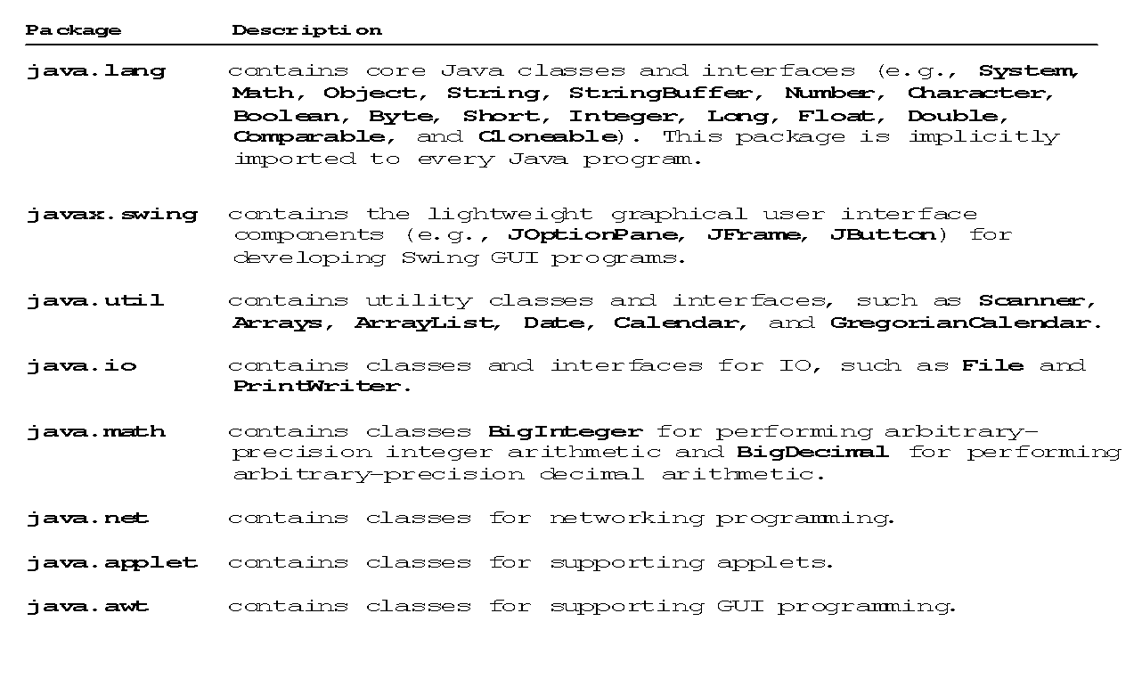
Java API Packages

Slide 46
Framework-Based Programming (1)
To create comprehensive projects, you have to use more classes and interfaces in the Java API.
The classes and interfaces in the Java API establish a framework for programmers to develop applications using Java.
For example, the classes and interfaces in the Java GUI API establish a framework for developing GUI programs.
You have to use these classes and interfaces and follow their conventions and rules to create applications. This is referred to as framework-based programming.

Slide 47
Framework-Based Programming (2)
Once you understand the concept of Java and object-orient programming, the most important lesson from now on is learning how to use the API to develop useful programs.
The most effective way to achieve it is to imitate good examples.

Slide 48
6. Design Patterns (1)
One important benefit of object-oriented programming is to reuse code.
For example, to create a button, you simply use the JButton class to create an instance of JButton. The JButton class is already defined in the Java API so you can use it without having to reinvent the wheel.
Design patterns are proven sound software strategies for designing classes. Applying design patterns is like reusing experience. You can apply successful patterns to develop new software without reinventing new solution strategies.

Slide 49
Design Patterns (2)
Expert designers do not solve every problem from scratch.
They reuse solutions that have worked for them in the past.
Design patterns speed up the development process by providing almost ready-made solutions that have been used earlier and proved to be effective and efficient.
Examples of pattern: The Singleton Pattern

Slide 50
The Singleton Pattern
Declares a class that can be used to instantiate a unique instance.
Used when it is desirable to restrict instantiation of a class to exactly one object.
public class MessageObject {
private static MessageObject instance = new MessageObject();
//make the constructor private so that this class cannot be
//instantiated
private MessageObject(){}
//Get the only object available
public static MessageObject getInstance(){
return instance;
}
public void showMessage(){
System.out.println("Hello World!");
}
}
public class SingletonPatternDemo {
public static void main(String[] args) {
//Compile Time Error: The constructor is not visible
MessageObject object = new MessageObject();
//Get the only object available
MessageObject object = MessageObject.getInstance();
object.showMessage();
}
}

Slide 51
7. Immutable Objects and Classes (1)
Normally, you create an object and allow its contents to be changed later. Occasionally, it is desirable to create an object whose contents cannot be changed once the object is created.
If the contents of an object cannot be changed once the object is created, the object is called an immutable object and its class is called an immutable class.
E.g., the String class is immutable.
String name=“TAR UMT”;
String message =new String(“Hello”);

Slide 52
Immutable Objects and Classes (2)
class Circle {
private double radius;
private static int numberOfObjects = 0;
public Circle(double radius) {
this.radius = radius;
numberOfObjects++;
}
public Circle() {
this(1.0);
}
public double getRadius() {
return radius;
}
public void setRadius(double radius) {
this.radius = radius;
}
public static int getNoOfObjects() {
return numberOfObjects;
}
public double findArea() {
return Math.PI * radius * radius;
}
}
If you delete the set method in the Circle class, the class would be immutable because radius is private and cannot be changed without a set method.
A class with all private data fields and without mutators is not necessarily immutable.

Slide 53
Example
public class Student { private int id; private BirthDate birthDate; public Student(int ssn, int year,
int month, int day) { id = ssn; birthDate = new BirthDate(year, month, day); } public int getId() { return id; } public BirthDate getBirthDate() { return birthDate; } }
public class BirthDate { private int year; private int month; private int day; public BirthDate(int newYear, int newMonth, int newDay) { year = newYear; month = newMonth; day = newDay; } public void setYear(int newYear) { year = newYear; } }
public class Test { public static void main(String[] args) { Student stud = new Student(111223333, 1970, 5, 3); BirthDate date = student.getBirthDate(); date.setYear(2010); // Now the student birth year is changed! } }

Slide 54
Points to note about the example:
Student class does not have a setBirthDate() method.
But within Test, the data field birthDate is returned using the getBirthDate() method and assigned to the variable date.
Now, date is holding a reference to a Date object.
Through this reference (date), the content for birthDate can be changed.

Slide 55
What Class is Immutable?
For a class to be immutable, it must meet all the following requirements:
Declare all data fields private
Provide no mutator methods
Provide no accessor methods that would return a reference to a mutable data field object

Slide 56
To Do
Review the slides and source code for this chapter.
Read up the relevant portions of the recommended text.
Do the tutorial and complete the remaining practical questions for this chapter.
We shall selectively discuss them during class.

